Slide 1
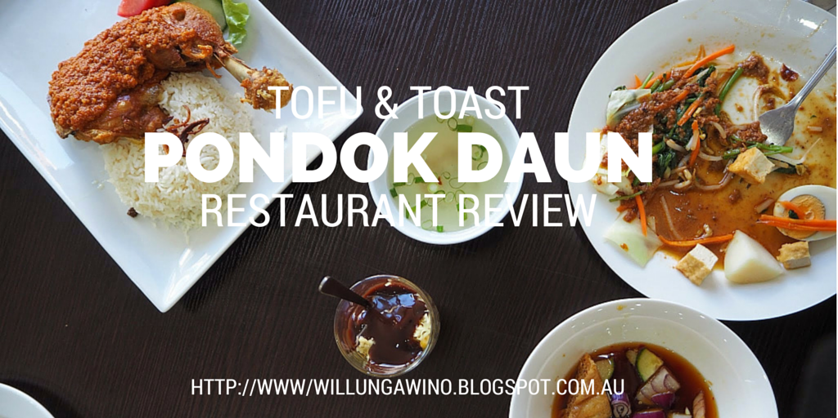

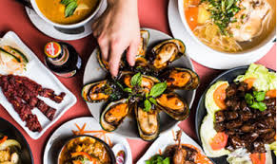
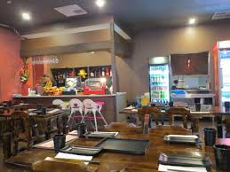
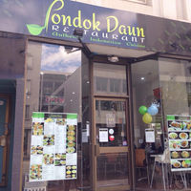

Slide 2
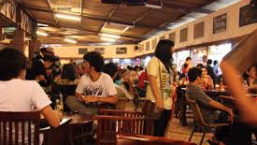
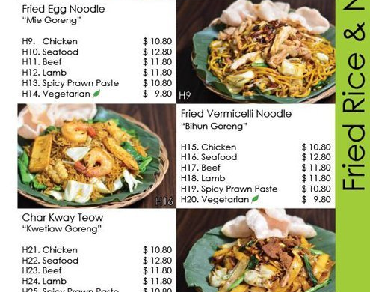
PONDOK Daun-A Better Place to Eat
Better Place To eat
Affordable
More offers given every week.
Trying to create More Business through Us.

Slide 3
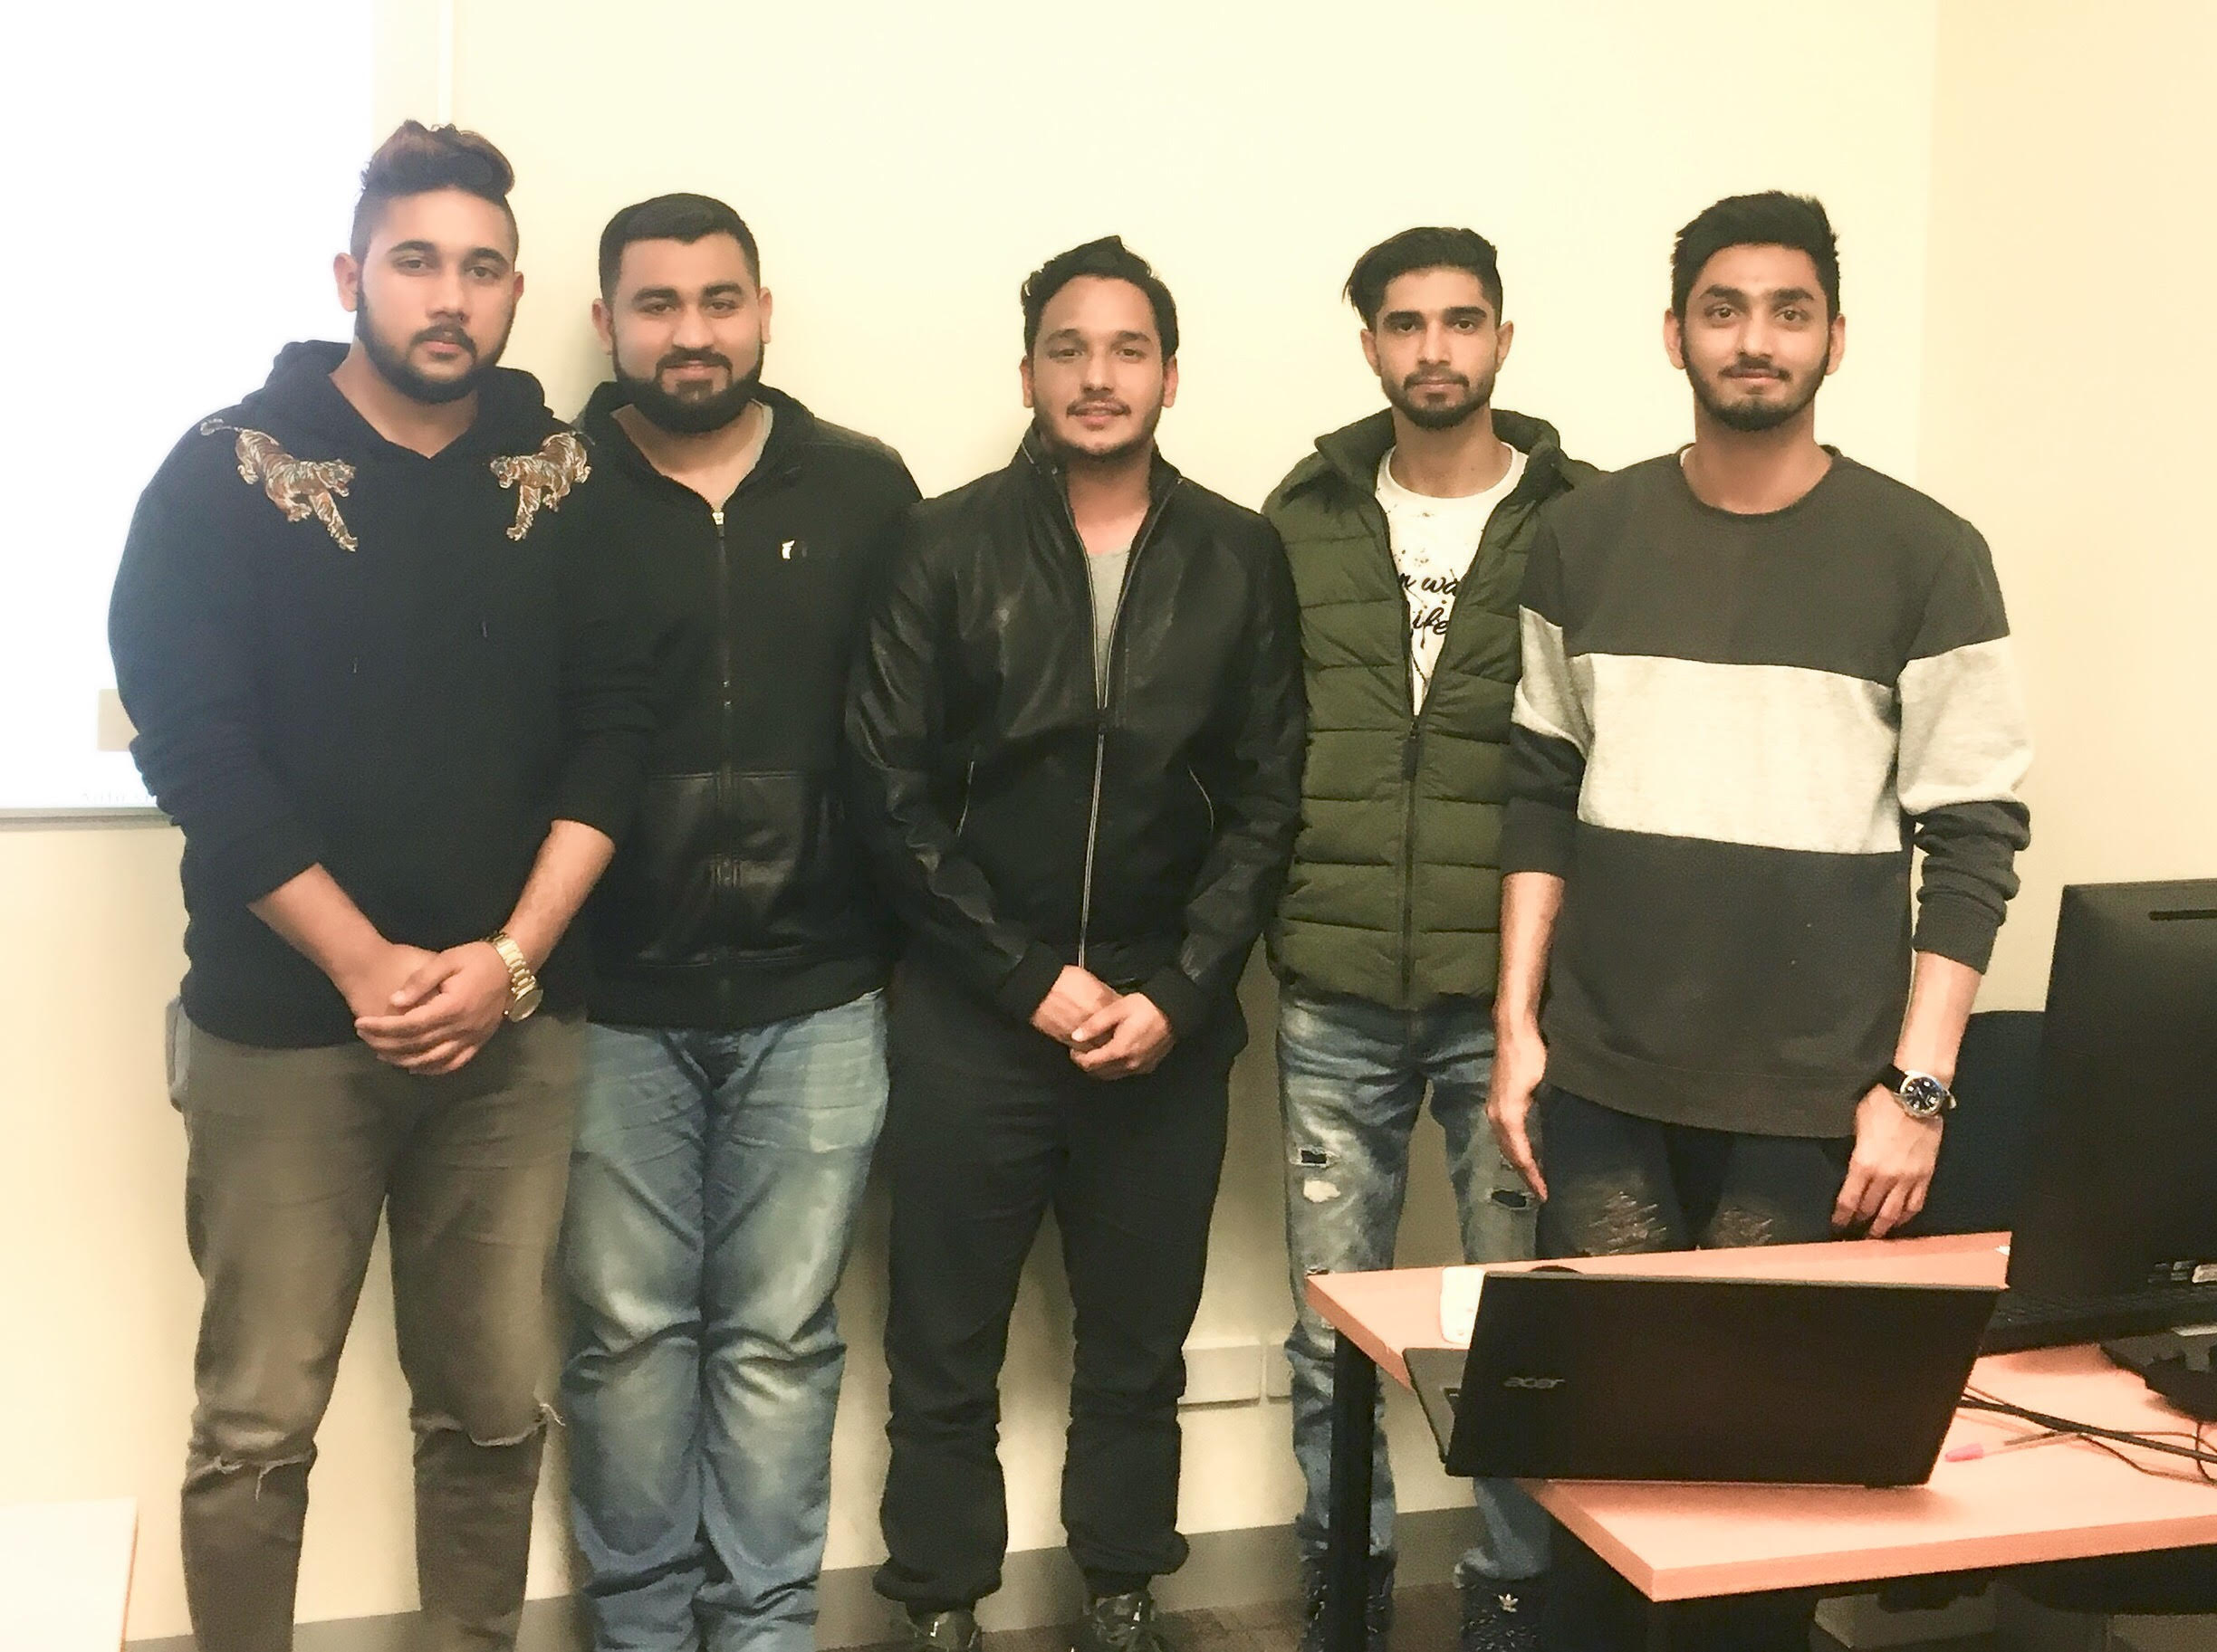

OZTECH- A CREATIVE TEAM
MEMBERS
. DILJOT SINGH
. ANMOL BATISH
. INDERJIT SINGH
. PARAS JOSHI
. MUHAMMAD ASFAND
Roles
Testing/Designer
Project Manager
Documentation
Database Manager
Documentation

Slide 4
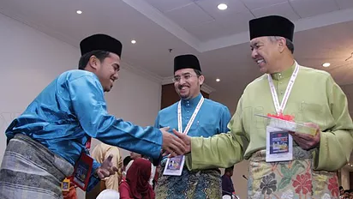
CLIENT
. Client Meetings worked very well.
. Mostly were at Restaurant locations.
. Were Basically on time.
. Time Management worked as discussed
. Communicated through email as well.

Slide 5
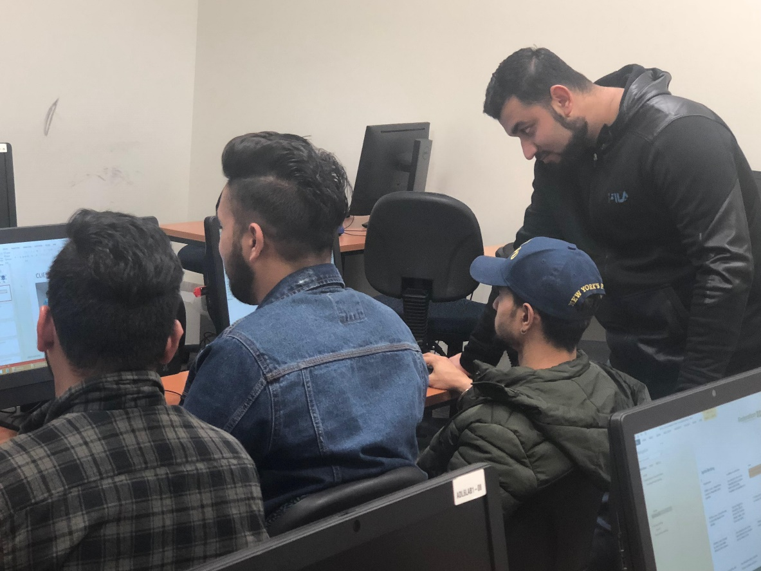
REFLECTIONS
Group Meetings
Meetings held mostly in Uni’s Library and Public Library.
Developers and Programmers help each other as well.
Each Member worked at it’s Peak

Slide 6

Client Meetings
Client meetings went well
Places are close by for both
Mainly at Restaurant & Cafes

Slide 7


STANDARDS
Google Drive
Data Accessing
Team Meeting Site
Data Interchanging

Slide 8
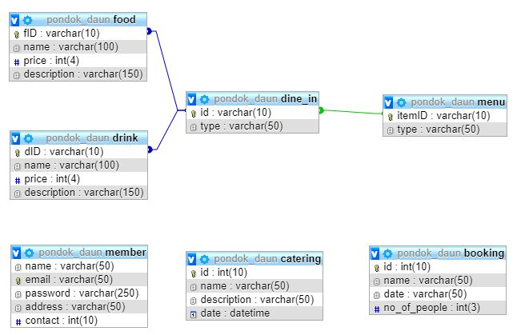
ER DIAGRAM

Slide 9
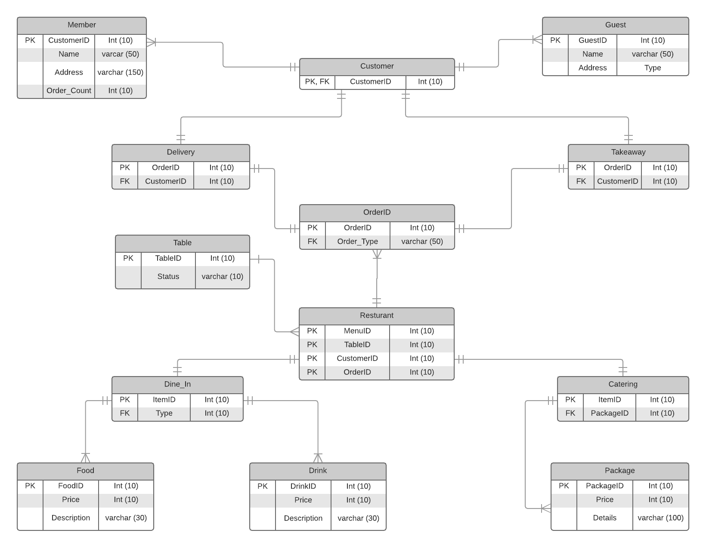
ER Diagram

Slide 10
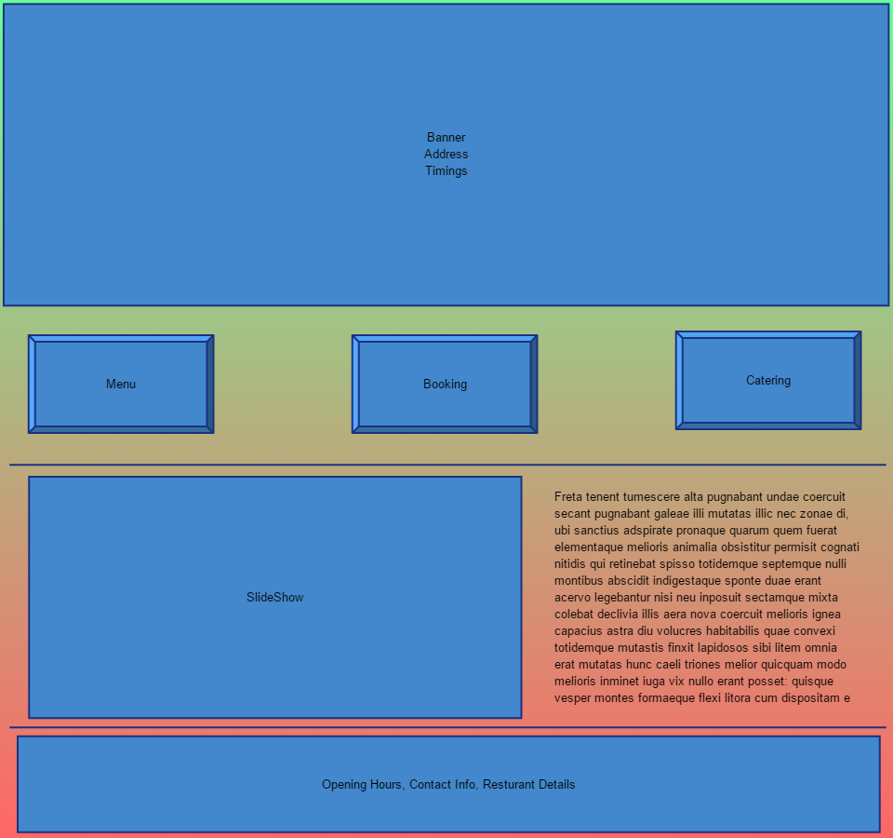
MOCKUP

Slide 11
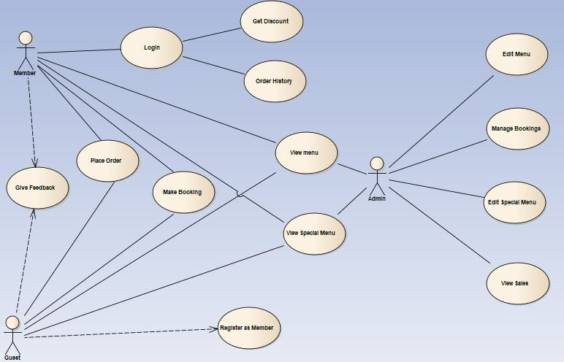
Use Case Diagram

Slide 12
FUNCTIONALITIES
View Products
Order & Update Details
Login
Booking
Review
Specials
Catering
Give Feedback
Contact Form
View Restaurant location.

Slide 13
DATABASE & WORKING FUNCTIONALITY

